Slide 1
Entity Relationship Model

Slide 2
ERD
It describes the data involved in a real world enterprise in terms of objects and their relationship
It illustrate the logical structure of databases .
It is used in a phase called conceptual database design
ER model is used mainly as a design tool and documentation for the system
Peter Chen developed ERDs in 1976.

Slide 3
Entity, Entity Set
Attributes
An entity is an object or concept about which you want to store information.
An entity may be an object with a physical existence (person, car) or with a conceptual existence(company,university)
Notes:
Entities :
To interpret the relational database you perceive the real world as a set of objects and relationships between these objects. These basic objects are called entities

Slide 4
Entity Set
An entity set is a set of entities of the same type that share the same properties or attributes
Attributes -
Attributes are descriptive properties possessed by each member of an entity set

Slide 5
Attribute types
  Simple & Composite
  Single-valued & Multi-valued
  Derived
    E.g Age: Age could be derived from date of Birth
F_Name
Emp-Name
Emp-Name
M_Name
L_Name
Stud_Name
Contact_Number
Age
Notes:
Key attribute
A key attribute is the unique, distinguishing characteristic of the entity. For example, an employee's social security number might be the employee's key attribute.
Multivalued attribute
A multivalued attribute can have more than one value. For example, an employee entity can have multiple skill values.
Derived attribute
A derived attribute is based on another attribute. For example, an employee's monthly salary is based on the employee's annual salary.
Key attribute
A key attribute is the unique, distinguishing characteristic of the entity. For example, an employee's social security number might be the employee's key attribute.
Multivalued attribute
A multivalued attribute can have more than one value. For example, an employee entity can have multiple skill values.
Derived attribute
A derived attribute is based on another attribute. For example, an employee's monthly salary is based on the employee's annual salary.

Slide 6
Relationship And Relationship Set
Relationship
A relationship is an association among several entities
A relationship can also have attributes
Relationship Sets
A relationship set is a set of relationships of a given type
Notes:
Examples:
Student registered in courses
Passengers booked on flights
Parents and their children
Bank branches, customers and their account

Slide 7
NOTATION FOR ER SCHEMAS
Symbol
Meaning
ENTITY TYPE
WEAK ENTITY TYPE
RELATIONSHIP TYPE
IDENTIFYING RELATIONSHIP TYPE
ATTRIBUTE
KEY ATTRIBUTE
MULTIVALUED ATTRIBUTE
COMPOSITE ATTRIBUTE
DERIVED ATTRIBUTE
TOTAL PARTICIPATION OF E₂ IN R
CARDINALITY RATIO 1:N FOR E₁:E₂ IN R
STRUCTURAL CONSTRAINT (min, max) ON PARTICIPATION OF E IN R
E₁
R
E₂
E₁
R
N
E₂
R
(min,max)
E

Slide 8
ER Diagram
amount
Soc SNo
loan-no
Cust-name
cust-city
borrower
CUSTOMER
LOAN
Notes:
There are two entity sets Customer and Loan. They are having a relationship between them as borrower. Customer is having attributes like Cust_name,cust_city and social security number(SSN). Primary key is Soc S N. Loan entity set is having attributes like loan-no and amount. Loan-amount is a primary key.

Slide 9
ERD
Identifying Entities
Given a system description you can identify entities by:
    Select all nouns
    Eliminate one’s not necessary
    Filter those for which system needs to stores record.
    Identify the attributes that describes the entity

Slide 10
Entity
Entities are classified as:
  DOMINANT ENTITIES: An entity that does not depend on another entity for its existence is a dominant or strong entity
  WEAK ENTITIES: An entity that depends on some other entity for its existence
Notes:
DOMINANT ENTITIES : An entity that does not depend on another entity for its existence is a dominant or strong entity.
WEAK ENTITIES : An entity that depends on some other entity for its existence

Slide 11
Existence Dependencies
If the existence of entity x depends on the existence of entity y, x is said to be existence dependent on y.
Entity y is said to be a Dominant entity and x is said to be a subordinate entity

Slide 12
Weak Entity
A weak entity does not have a primary key of its own
You can use a combination of the primary key of the dominant entity & an attribute of the weak entity as the primary key of the weak entity.
Thus a discriminator of Weak Entity + Prime attribute of the its Dominant Entity.
Emp_id
EMPLOYEE
Emp_id+Nom_id+Relation
Has
NOMINEE
Notes:
WEAK ENTITY :
For eg : KEY_PERSON_NAME cannot uniquely identify a key person Hence SUPP_CODE & KEY_PERSON_NAME can be used as a key.

Slide 13
Entities are linked to each other through relationships. Hence a relationship is an association between 2 entities.
eg:
Entity Relationship Entity
  SUPPLIER supplies ITEM

Slide 14
Participation of an entity set in a relation
Total: The participation of an entity set E in a relationship set R is said to be total if every entity in E participates in at least one relationship R
Partial: Part of the set of entities participate in some relationship

Slide 15
Total & Partial Participation
amount
Soc SNo
loan-no
Cust-name
cust-city
borrower
CUSTOMER
LOAN
Notes:
Customer may or may not apply for a loan . But there will exist no loan without a customer. Hence participation of loan is total.

Slide 16
Degree of Relationship
Unary : Degree 1
Binary : Degree 2
Ternary : Degree 3
N-ary : Degree n
EMPLOYEE
manages
Soc SNo
loan-no
amount
Cust-name
cust-city
borrower
LOAN
CUSTOMER
ORDER
Has
ITEM
Order_dtls

Slide 17
Cardinality Ratio/
Mapping Cardinality
Mapping Cardinality express the number of entities to which another entity can be associated via a relationship set

Slide 18
Relational Database ER
1-1
  Supplier------Key Person
1-M
  Dept-----Emp
M-1
  Emp-----Dept
M:M
  Student----Subject

Slide 19
ERD
Once the entities & relationship between the entities is identified you can represent them in a ER diagram

Slide 20
ER Example
fname
mname
lname
detno
dname
loc
empno
ename
sal
N
Belongs to
1
DEPT
EMP
1
No of hrs
1
M
has
Assigned to
Manages
N
N
1
DEPENDENTS
PROJECT
Dep_name
relation
proj_id
projname

Slide 21
ER …(contd.)
This schema has 3 entity types
  EMPLOYEE
  DEPT
  PROJECT
& one weak entity type DEPENDENT
There is M:N relationship between PROJECT and EMP
entity sets
There is a 1:1 relationship between DEPT and PROJECT
There is a 1:M relationship between DEPT and EMP
entity sets
No of hrs is an attribute on the relation “assigned to” between EMP and PROJECT

Slide 22
Enhanced features of ER Model

Slide 23
Enhanced-ER (EER) Model Concepts
Includes all modeling concepts of basic ER
Additional concepts: subclasses / superclasses, specialization/generalization, categories, attribute inheritance
The resulting model is called the enhanced-ER or Extended ER (E2R or EER) model
It is used to model applications more completely and accurately if needed
It includes some object-oriented concepts, such as inheritance

Slide 24
Subclasses and Superclasses
An entity type may have additional meaningful sub groupings of its entities
Example: EMPLOYEE may be further grouped into SECRETARY, ENGINEER, MANAGER, TECHNICIAN, SALARIED_EMPLOYEE, HOURLY_EMPLOYEE,…
  Each of these groupings is a subset of EMPLOYEE entities
  Each is called a subclass of EMPLOYEE
  EMPLOYEE is the superclass for each of these subclasses
These are called superclass/subclass relationships.
Example: EMPLOYEE/SECRETARY, EMPLOYEE/TECHNICIAN
These are also called IS-A relationships (SECRETARY IS-A EMPLOYEE, TECHNICIAN IS-A EMPLOYEE, …).

Slide 25
Attribute Inheritance in Superclass / Subclass Relationships
An entity that is member of a subclass inherits all attributes of the entity as a member of the superclass
It also inherits all relationships

Slide 26
Specialization
Is the process of defining a set of subclasses of a superclass
The set of subclasses is based upon some distinguishing characteristics of the entities in the superclass
Example: {SECRETARY, ENGINEER, TECHNICIAN} is a specialization of EMPLOYEE based upon job type.
  May have several specializations of the same superclass
Example: Another specialization of EMPLOYEE based in method of pay is {SALARIED_EMPLOYEE, HOURLY_EMPLOYEE}.
  Superclass/subclass relationships and specialization can be diagrammatically represented in EER diagrams
  Attributes of a subclass are called specific attributes. For example, TypingSpeed of SECRETARY
  The subclass can participate in specific relationship types. For example, BELONGS_TO of HOURLY_EMPLOYEE

Slide 27
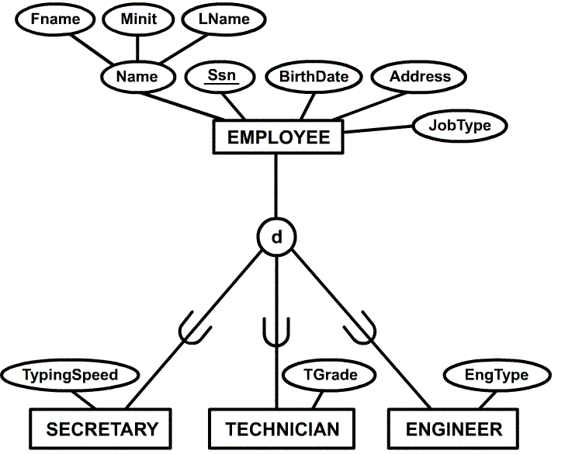
Example of a Specialization

Slide 28
Generalization
The reverse of the specialization process
Several classes with common features are generalized into a superclass; original classes become its subclasses
Example: CAR, TRUCK generalized into VEHICLE; both CAR, TRUCK become subclasses of the superclass VEHICLE.
  We can view {CAR, TRUCK} as a specialization of VEHICLE
  Alternatively, we can view VEHICLE as a generalization of CAR and TRUCK

Slide 29
Constraints on Specialization and Generalization
If we can determine exactly those entities that will become members of each subclass by a condition, the subclasses are called predicate-defined (or condition-defined) subclasses
  Condition is a constraint that determines subclass members
  Display a predicate-defined subclass by writing the predicate condition next to the line attaching the subclass to its superclass
If all subclasses in a specialization have membership condition on same attribute of the superclass, specialization is called an attribute defined-specialization
  Attribute is called the defining attribute of the specialization
  Example: JobType is the defining attribute of the specialization {SECRETARY, TECHNICIAN, ENGINEER} of EMPLOYEE
If no condition determines membership, the subclass is called user-defined
  Membership in a subclass is determined by the database users by applying an operation to add an entity to the subclass
  Membership in the subclass is specified individually for each entity in the superclass by the user

Slide 30
Constraints on Specialization and Generalization
Two other conditions apply to a specialization/generalization:
Disjointness Constraint:
  Specifies that the subclasses of the specialization must be disjointed (an entity can be a member of at most one of the subclasses of the specialization)
  Specified by d in EER diagram
  If not disjointed, overlap; that is the same entity may be a member of more than one subclass of the specialization
  Specified by o in EER diagram
Completeness Constraint:
  Total specifies that every entity in the superclass must be a member of some subclass in the specialization/ generalization
  Shown in EER diagrams by a double line
  Partial allows an entity not to belong to any of the subclasses
  Shown in EER diagrams by a single line

Slide 31
Constraints on Specialization and Generalization
Hence, we have four types of specialization/generalization:
  Disjoint, total
  Disjoint, partial
  Overlapping, total
  Overlapping, partial
Note: Generalization usually is total because the superclass is derived from the subclasses.

Slide 32
Example of disjoint partial Specialization

Slide 33
Categories (UNION TYPES)
All of the superclass/subclass relationships we have seen thus far have a single superclass
A shared subclass is subclass in more than one distinct superclass/subclass relationships, where each relationships has a single superclass (multiple inheritance)
In some cases, need to model a single superclass/subclass relationship with more than one superclass
Superclasses represent different entity types
Such a subclass is called a category or UNION TYPE
Example: Database for vehicle registration, vehicle owner can be a person, a bank (holding a lien on a vehicle) or a company.
  Category (subclass) OWNER is a subset of the union of the three superclasses COMPANY, BANK, and PERSON
  A category member must exist in at least one of its superclasses

Slide 34
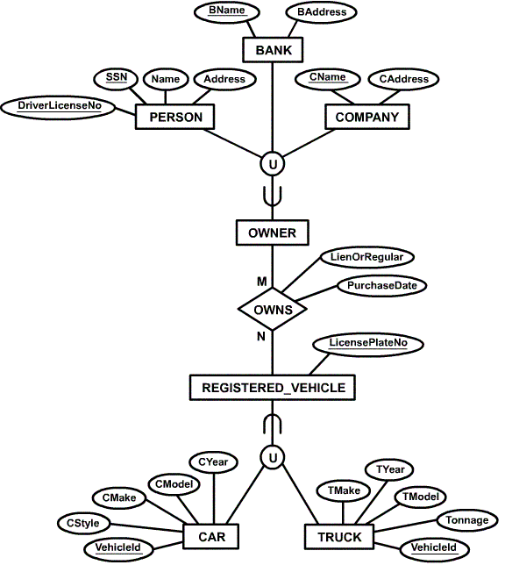
Example of categories
(UNION TYPES)

Slide 35
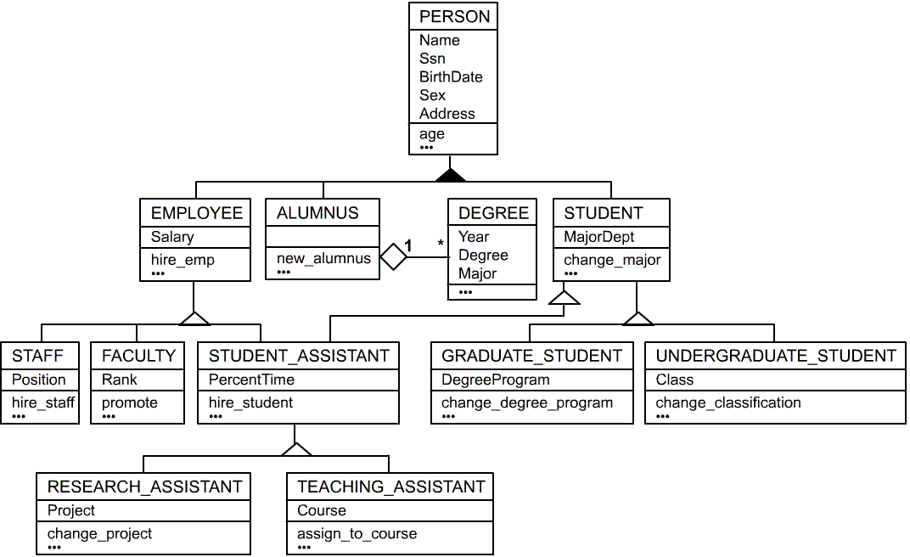
UML Example for Displaying Specialization / Generalization

Slide 36
ER to Relational Mapping
Step 1:
For regular entity E, create relation R including simple attributes and simple component of a composite attribute
Choose one of the key attribute as a primary key for all strong entities

Slide 37
ER to Relational Mapping…(contd.)
Step 1:
EMP
p . k
empno
fname
mname
lname
sal
DEPT
p. k
deptno
dname
loc
PROJECT
p . k
Proj_id
projname
DEPENDENT
Super key
empno
Dep_name
relation

Slide 38
ER to Relational Mapping…(contd.)
Step 2:
  For each weak entity type W in the ER schema with owner entity type E,we create a relation R and include all simple attributes of W as attributes of R
  In addition, we include as foreign key attributes of R, the primary key attributes of the relation that corresponds to the owner entity type E.
  The primary key of R is the combination of the primary key of the owner & the partial key of the weak entity type W
Notes:
For each weak entity type W in the ER schema with owner entity type E,we create a relation R and include all simple attributes of W as attributes of R . In addition , we include as foreign key attributes of R ,the primary key attributes of the relation that corresponds to the owner entity type E. The primary key of R is the combination of the primary key of the owner & the partial key of the weak entity type W

Slide 39
ER to Relational Mapping…(contd.)
Step 2:
EMP
P .k
f. k
empno
fname
mname
lname
sal
deptno
P .k
DEPT
f. k
deptno
dname
loc
P .k
PROJECT
Proj_id
Proj_name
deptno
DEPENDENT
Super key
empno
Dep_name
relation
Notes:
For each binary M:N relationship type R, we create a new relation S to represent R. We include as foreign key attributes in S the primary keys of the relations that represent the participating entity types ; their combination will form the primary key of S. We also include any simple attributes of the M:N relationship type as attributes of S.

Slide 40
ER to Relational Mapping…(contd.)
Step 3:
  For each binary 1:1 relationship type R, we identify the relations S and T that correspond to the entity types participating in R
  We choose one of the relations S ,say & include as a foreign key in S the primary key of T. Choose an entity type with total participation in R in the role of S.
  We include all the simple attributes of the 1:1 relationship R as attributes of S
Notes:
For each binary 1:1 relationship type R we identify the relations S and T that correspond to the entity types participating in R . We choose one of the relations S ,say & include as a foreign key in S the primary key of T. Choose an entity type with total participation in R in the role of S. We include all the simple attributes of the 1:1 relationship R as attributes of S.

Slide 41
ER to Relational Mapping…(contd.)
Step 3:
EMP
P . k
f. k
empno
fname
mname
lname
sal
deptno
DEPT
P .k
deptno
dname
loc
P .k
PROJECT
f. k
Proj_id
Proj_name
deptno
DEPENDENT
Super key
empno
Dep_name
relation

Slide 42
ER to Relational Mapping…(contd.)
Step 4:
  For each regular (nonweak) binary 1:N relationship type R, we identify the relation S that represents the participating entity type at the N-side of the relationship type.
  We include as foreign key in S the primary key of relation T that represents the other entity type participating in R; this is because each entity instance on the N-side is related to at most one entity instance on 1 side of relationship type.
Notes:
For each regular (nonweak) binary 1:N relationship type R, we identify the relation S that represents the participating entity type at the N-side of the relationship type . We include as foreign key in S the primary key of relation T that represents the other entity type participating in R ; this is because each entity instance on the N-side is related to at most one entity instance on 1 side of relationship type.

Slide 43
ER to Relational Mapping…(contd.)
Step 4:
EMP
P .k
F .k
empno
fname
mname
lname
sal
deptno
P .k
DEPT
deptno
dname
loc
P .k
PROJECT
f. k
Proj_id
Proj_name
deptno
Super key
DEPENDENT
empno
Dep_name
relation

Slide 44
ER to Relational Mapping…(contd.)
Step 5:
  For each binary M:N relationship type R, we create a new relation S to represent R.
  We include as foreign key attributes in S the primary keys of the relations that represent the participating entity types.
  The combination will form the primary key of S. We also include any simple attributes of the M:N relationship type as attributes of S.

Slide 45
ER to Relational Mapping…(contd.)
Step 5:
EMP
P .k
F .k
empno
fname
mname
lname
sal
deptno
DEPT
P .k
deptno
dname
loc
P .k
PROJECT
f. k
Proj_id
Proj_name
deptno
Super key
EMP_PROJ
Empno
Proj_id
No_of_hrs
Super key
DEPENDENT
empno
Dep_name
relation

